Slide 1

Cloud computing
Name : Omkar Bhausaheb Phalke
Roll no :- 10

Slide 2

Contents:
What is Cloud Computing
History of Cloud Computing
Benefit of Cloud Computing
Types of Cloud Cloud
Service Model
Security on Cloud
Conclusion

Slide 3
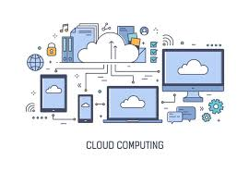
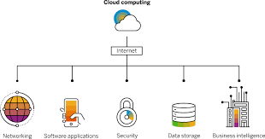
What is Cloud Computing?
Cloud computing refers to the delivery of computing services-including servers, storage, databases, networking, software, analytics, and intelligence-over the Internet (the cloud). Companies offer these services on a pay-as-you- go basis, making it easier for organizations to consume and pay for computing resources.

Slide 4
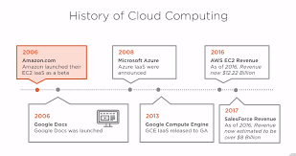
History of Cloud Computing :-
The concept of cloud computing as we know it today, however, really began to take shape in the late 1990s and early 2000s. In 1999, Salesforce.com launched the first software as a service (SaaS) application, allowing customers to access customer relationship management (CRM) software over the internet. In 2002, Amazon Web Services (AWS) introduced its first cloud computing offering, providing on-demand access to computing resources such as storage, processing power, and networking

Slide 5
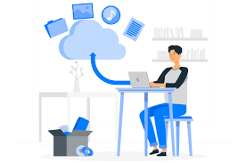
Benefits of Cloud Computing :-
There are several benefits to using cloud computing services:
Cost savings
Scalability
Flexibility
Reliability
Security

Slide 6
Benefits of cloud Computing :-
Cost savings: With cloud computing, organizations can pay for only the resources they need, when they need them, which can result in significant cost
Savings Scalability: Cloud computing resources can be easily scaled up or down as needed, allowing organizations to quickly adjust to changing business needs.
Flexibility: Cloud computing allows organizations to access a wide range of resources and services, which can be easily configured and customized to meet their specific needs.
Reliability: Cloud computing services are generally highly available and reliable, with service-level agreements (SLAs) that guarantee uptime.
Security: Cloud computing providers invest heavily in security and frequently update their systems to protect against the latest threats.

Slide 7
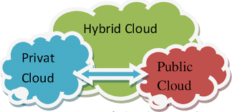
Types of Cloud
There are several types of clouds, which can be classified based on various criteria such as the location of the infrastructure, the ownership of the infrastructure, and the delivery model of the services. Here are some common types of clouds:
Public Cloud
Private Cloud
Hybrid Cloud

Slide 8
Cloud Service Model
There are three main types of cloud computing services:
Infrastructure as a Service (IaaS): This is the most basic type of cloud computing service and provides access to infrastructure resources such as virtual machines, storage, and networking.
Platform as a Service (PaaS): PaaS provides a platform for developing, testing, and deploying applications. It includes the infrastructure resources provided by laaS, as well as additional tools and services for developing and managing applications.
Software as a Service (SaaS): SaaS provides access to software applications over the Internet, on a pay-as-you-go basis. Users do not need to install or maintain the software on their own devices.

Slide 9

Security on Cloud
There are several security measures that can be implemented in cloud environments to protect against various threats :-
Access control Encryption
Network security
Infrastructure security
Compliance

Slide 10
Security on Cloud Cont.
Access control: Users and applications should only be granted access to resources that they are authorized to use. This can be achieved through mechanisms such as identity and access management systems and role-based access controls.
Encryption: Sensitive data should be encrypted both at rest and in transit to prevent unauthorized access. This includes data stored in cloud storage as well as data transmitted over networks.
Network security: Network security measures such as firewalls, virtual private networks (VPNs), and intrusion detection and prevention systems can help protect against network-based attacks.
Infrastructure security: Cloud providers should implement measures to secure the physical infrastructure that supports their services, such as data centers and servers.
Compliance: Organizations should ensure that their use of cloud services complies with relevant laws, regulations, and industry standards. This includes implementing measures to protect personal data in accordance with data protection laws such as the EU's General Data Protection Regulation (GDPR).

Slide 11
Conclusion :-
Cloud computing has revolutionized the way organizations consume and pay for computing resources, providing significant cost savings, scalability, flexibility, reliability, and security. With a wide range of services and providers to choose from, it is easier than ever for organizations to take advantage of the benefits of the cloud.

